Slide 1

Analyzing Probabilities of the Black Lion Chest Loot Box
Christian Simpson

Slide 2

What is the Black Lion Chest?
Loot Boxes in Guild Wars 2
Acquire through normal gameplay
Must buy keys to open
Keys cost Gems
Contain Exclusive Weapon, Armor and Mount Skins not available through gameplay
The holiday “Wintersday” Banner Image from the Black Lion Outpost (2023).

Slide 3
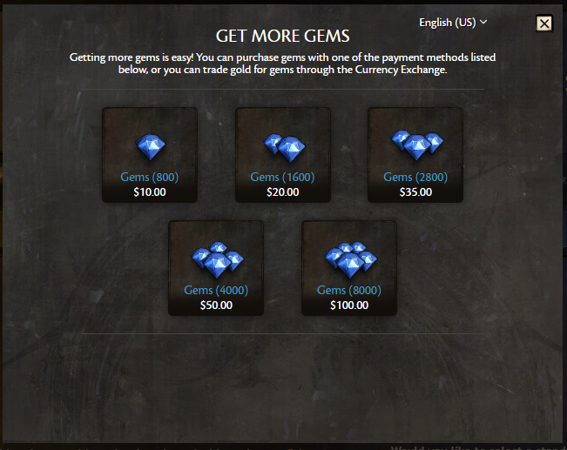
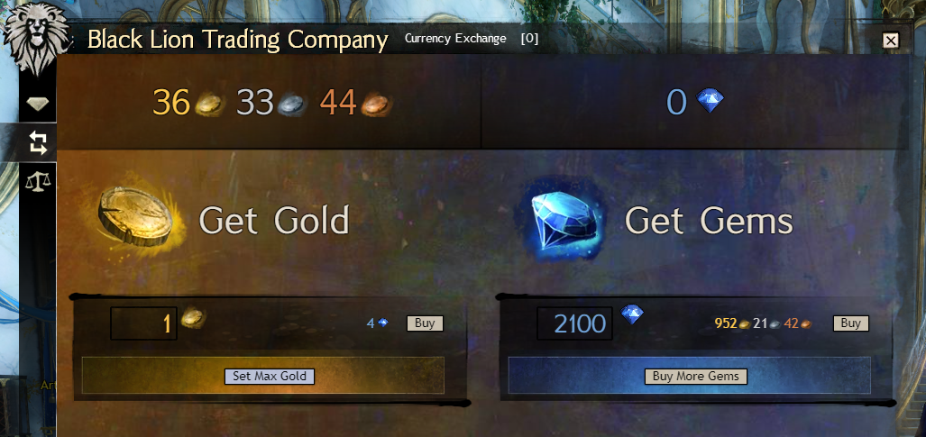
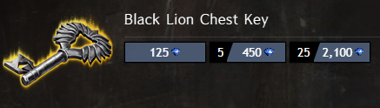
Gold, Gems, and Real Money Transfer
Buying Gems with real money.
Cost of bundles of keys.
The Gold-to-Gems exchange menu.

Slide 4

Sample Cost
n = 33415
33415 Chests / 25-Pack Keys = 1337 Key Packs (Nice)
1337 * 2100 Gems per Pack = 2,807,700 Gems
2807700 / 8000 = 350.9625
8000 Pack is the largest bundle of Gems available
No discounts on bundles
350.9625 * $100 = 35096.25 + 35096.25 * .06 = $37,202.025

Slide 5

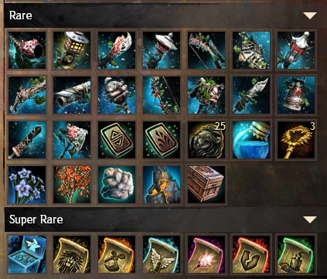
What’s in it?
Set Theory (2.3)
Universal Set contains all possible items
5 subsets of the universal set:
Slot 1: Guaranteed Statue
Slot 2: Guaranteed seasonal bag
Slot 3: Guaranteed Common Items 1
Slot 4: Guaranteed Common Items 2
Slot 5: Chance of Uncommon or Better Item
4 Subsets: Exclusive Items, Uncommon Items, Rare Items, Super Rare Items

Slide 6
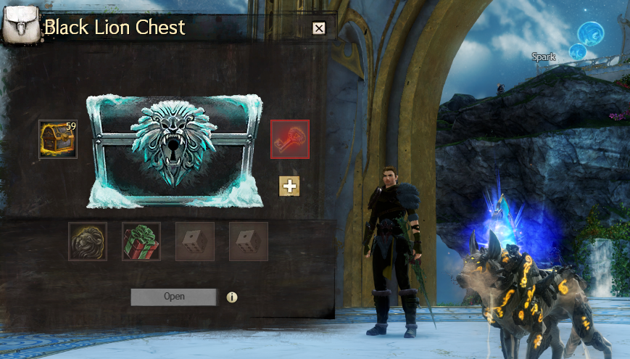
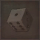
Simple Probabilities (2.4 / 2.5 / 2.6)
Slot 1 and 2 each have one fixed event.
Slot 3 has 7 possible events.
Slot 4 has 11 possible events.
77 sample points exist for (S3, S4).
Slot 5’s events are dependent. Its probability of observation is given by:
Observed Successes = 3325 / 33415 = .0995
4,543 sample points exist for (S3, S4, S5).
77 * 6 Exclusives +
77 * 20 Uncommons +
77 * 26 Rares +
77 * 7 Super Rares
I’m poor
1
1
7
11
~ 10%
Slots 1 - 4 Guaranteed | Slot 5 Not Guaranteed

Slide 7
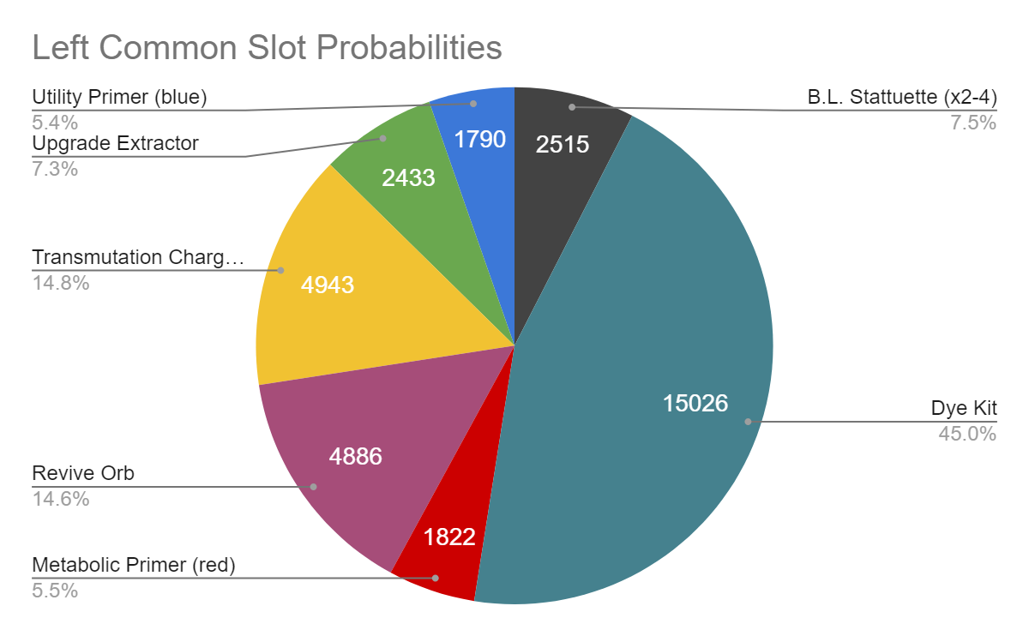
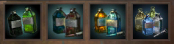
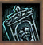
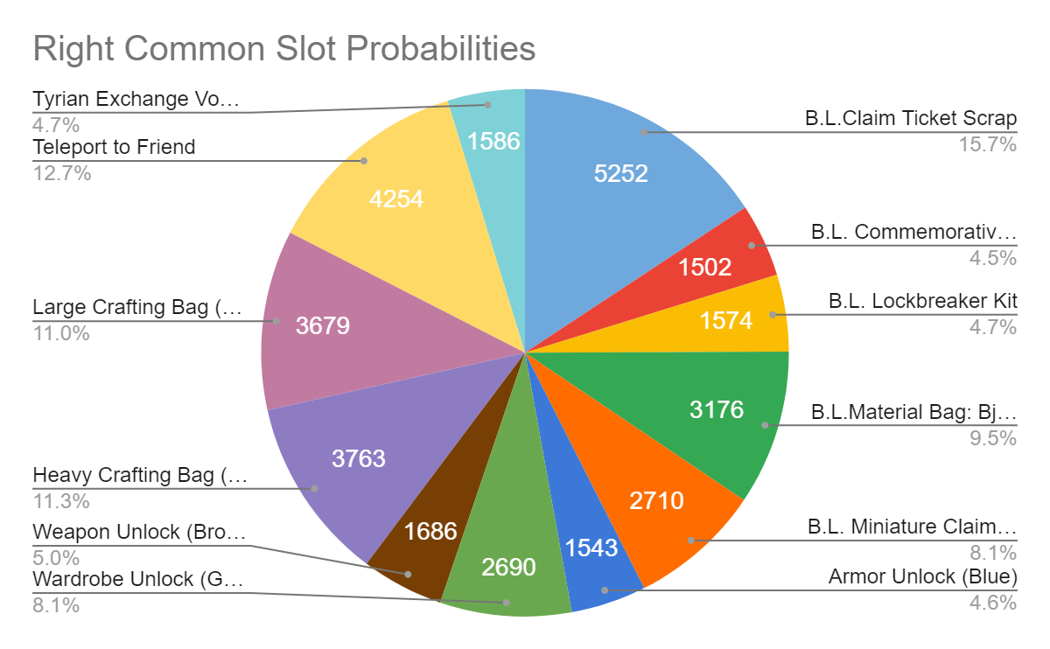
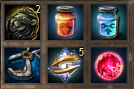
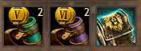
Simple Probability Calculation
Intersection
Chance of a Dye Kit AND an Armor Unlock: P(Ed) * P(Ea) = .45 * .046 = .0207
Compliment
Chance of any item in Slot 3 BESIDES a Dye Kit: 1 - P(Ed) = .55
Union
Chance of any bag of materials: P(Eb) + P(El) + P(Eh) = .095 + .113 + .11 = .318

Slide 8
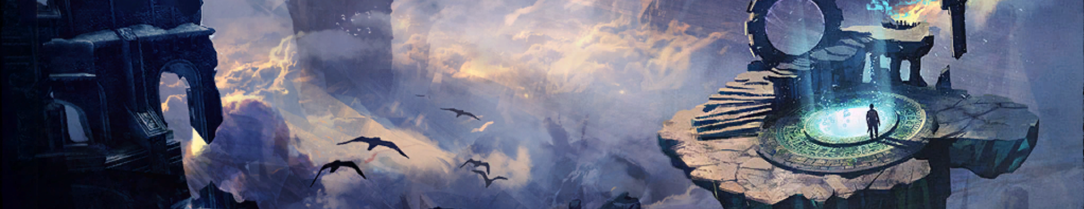
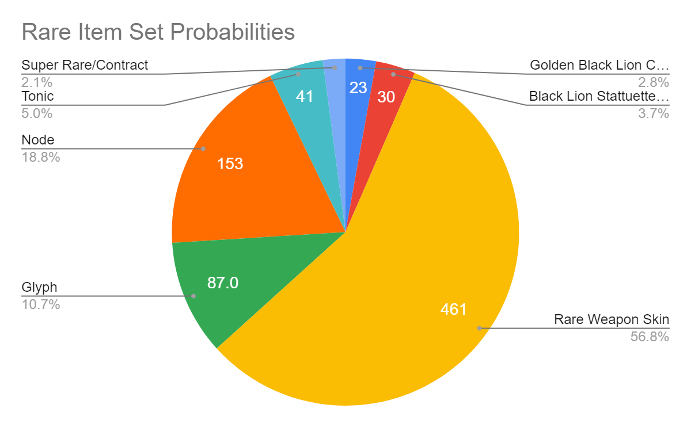
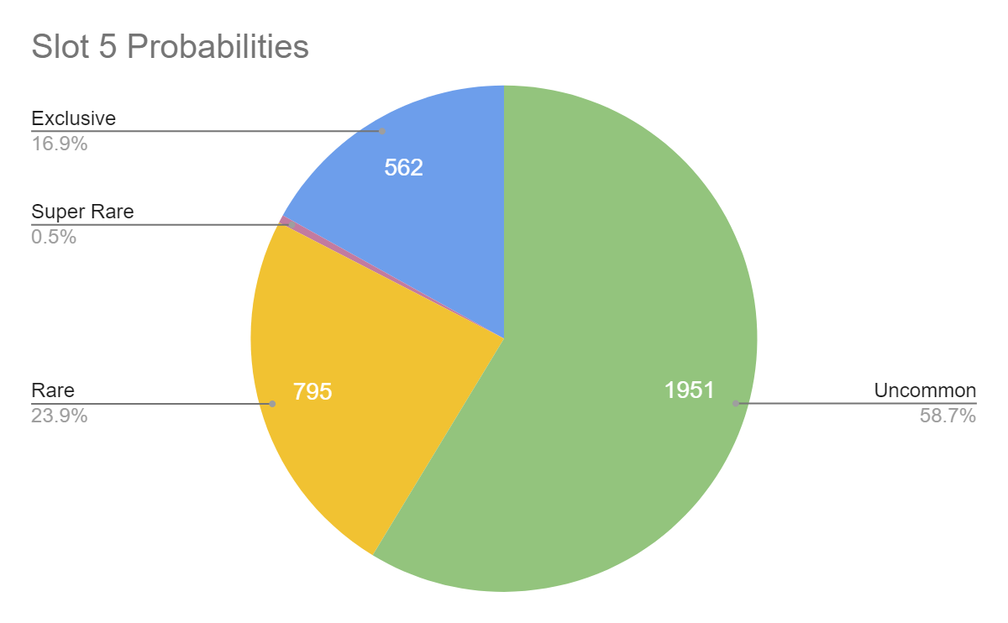
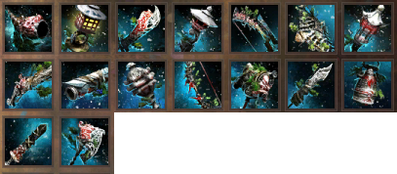
Conditional Probability and Dependence (2.7)
What is the probability we pull a Rare Weapon Skin given the 5th Item Slot is available?
P(B|A) = P(AnB) / P(A)
P(Er|E5) = P(Er AND E5) / P(E5)
P(Er|E5) = .568
Because P(AnB) == P(A)P(B), these events are independent.

Slide 9
Bayes’ Theorem (2.10)
Let’s assume the player knows the probability of pulling a Rare Item is .239, and the probability to get a Weapon Skin regardless of its rarity is .742 - Should the player spend the one key they have and try to get a Rare Weapon Skin? P(R) = .239 P(W|R) + P(W|R’) = .742 P(W|R) = .568 P(R|W) = (.568 * .239) / .742 = .1829
The assumption also leaves out the conditional probability of Slot 5 appearing, so with only one attempt, the player should probably save their keys until they have more.

Slide 10
Binomial Distribution (3.4)
Geometric Distribution (3.5)
What is the chance that we find at least one item from Slot 5 of the Black Lion Chest in 25 attempts?
p = .0995 q = 1 - p = .9005 y >= 1 n = 25 Calculate y = 0 and take the compliment. p(y = 0) = (25C0)(.0995^0)(.9005^25) = .0728 P(y >= 1) = 1 - p(y = 0) = .927
What is the chance that we find one item from Slot 5 of the Black Lion Chest as the 9th AND 10th attempts out of 10 trials?
p = .0995 q = .9005 y = 9 Calculate p(y=9) and intersect the probability of a success for the 10th trial.
p(y = 9) = (.9005^8)(.0995) = .043
p(y = 9) * .0995 = .0043

Slide 11

Negative Binomial Distribution (3.6)
Hypergeometric Distribution (3.7)
What is the probability that when opening 25 chests, a player pulls their first Super Rare item on the 12th try?
r = 12
y = 25
p = p(Es|E5) = .005
q = 1 - p = .995
p(12) = (24C11)(.005^12)(.995^13)
p(12) = .000000000000000000005709
Let’s assume a player receives a Rare item. What is the probability it is the single one of six exclusive items that they want?
N = 26, n = 1
r = 6, y = 1
p(1) = (6C1)(20C0) / (26C1)
p(1) = .231
There is about a 23% chance the player receives the exclusive they want when they receive a Rare Item.

Slide 12
Poisson Distribution (3.8)
Assuming the average number of Rare items earned per hour is 1, what is the probability that, in one hour, a player opens…
One Rare Item?
Two Rare Items?
Four Rare Items?
At least two Rare Items?
𝜆 = 1
p(1) = [(1^1)(e^-1)] / 1! = .368
p(2) = [(1^2)(e^-1)] / 2! = .184
p(4) = [(1^4)(e^-1)] / 4! = .015
p(y>=2) = 1 - p(0) + p(1) = .264
Assuming this average, the player has a good chance to pull at least 2 Rare Items in an hour of opening chests.

Slide 13
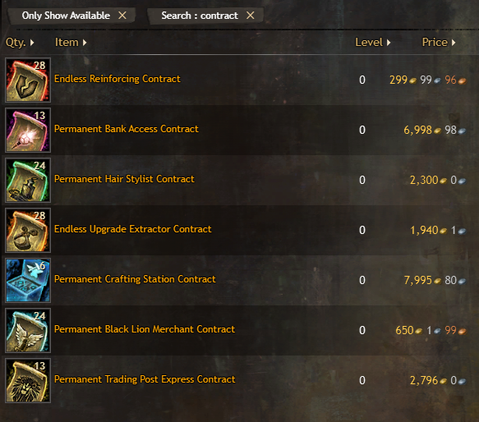
Tchebysheff’s Theorem (3.11)
Assume Uncommon Items are observed with an average of .5 and standard deviation of .01. Find a lower bound for the number of chests in a lot of 400 that are expected to contain Uncommon items with a .48 to .52 observation rate.
“Within Number” = .52 - .5 / .01 = 2
Observations within 2 standard deviations = 1 - .5^2 = .75
Lower Bound = .75 * 400 = 300
The lower bound for the amount of chests in a lot of 400 that may contain Uncommon Items is 300 chests.

Slide 14
Uniform Probability Distribution (4.4)
Upon studying the number of keys purchased by players in one session of play, ArenaNet finds that the number of keys purchased are uniformly distributed between 20 and 25. Find the probability that the number of keys purchased by any one player on their next login session
a. is below 22.
b. is in excess of 24.
p(y < 22) = 22-20 / 25-20 = .4
p(y <= 24) = 24-20 / 25-20 = .8
p(y > 24) = 1 - p(y<=24) = 1 - .8 = .2
Bonus: What is the Expected for this variable? The variance?
E(Y) = b + a / 2 = 25 + 20 / 2 = 22.5 Keys
V(Y) = E(Y^2) - [E(Y)]^2 = (b-a)^2 / 12 = 2.08 Keys

Slide 15
Gamma Distribution (4.6)
A regular user of GW2Efficiency.com observes that on any given time during the week, the ratio of gold to gem conversion through the Trading Post has an approximately exponential distribution with mean 100 Gold. As more gold enters the exchange, the demand rises, and with it the price of gems.
Find the probability that the exchange ratio will exceed 200 Gold on any randomly selected day.
What Gold-exchange capacity should the players attempt to maintain so that the probability that demand will exceed capacity on a randomly selected day is only .01?
μ = 100 β = 100 α = 1
p(200) = 1/β * e^-y/β on 3 <= y < ∞
P’(200) = 1 - e^-y/100 = 1 - .135 = .865
At approximately an 86.5% chance to exceeding 200 Gold on average for the exchange ratio, users can almost always expect to spend more gold if they want to buy gems.
p(Y <= y) = .01
1 - e^-y/β = .01 -> e^-y/β = .99
-y/β = ln(.99)
y = -ln(.99)β = 100 * .01005 = 1.005 Gold
This exchange capacity is all but impossible to maintain as 4 Gems costs 1 Gold. The capacity will certainly always increase, driving up the exchange rate.

Slide 16
Bivariate / Multivariate Distribution (5.2)
Consider a sample space of 3 chests to be opened. For this experiment, suppose we open each chest and record if Slot 5 is observed. Let x be the observations of Slot 5, and y the amount of Gold won on a side bet with a member of your Guild in the following manner:
If you receive an uncommon or better item on the first chest, you get 5 Gold (enough to buy another key).
If you get it on chest 2 or 3, you earn 10 or 15 gold respectively.
If you don’t get a 5th item from any chest, you have to buy your friend a key (-5 Gold).
Find the Joint Probability Function for x and y.
What is the probability you will have to buy your friend a key? (Find P(0, -5).
P(y1, y2) is given by the table drawn here.
Note: P(2, 5) has two possible events, YNY and YYN.
To calculate P(0, -5) we find any events that fit the criteria and take the union.
One possible event exists with a probability of .125.
 | 0 | 1 | 2 | 3
-5 | 1/8 | 0 | 0 | 0
5 | 0 | 1/8 | 1/4 | 1/8
10 | 0 | 1/8 | 1/8 | 0
15 | 0 | 1/8 | 0 | 0

